Slide 1
Introduction to Markov Random Fields and Graph Cuts
Simon Prince
s.prince@cs.ucl.ac.uk

Slide 2
Plan of Talk
Denoising problem
Markov random fields (MRFs)
Max-flow / min-cut
Binary MRFs (exact solution)

Slide 3
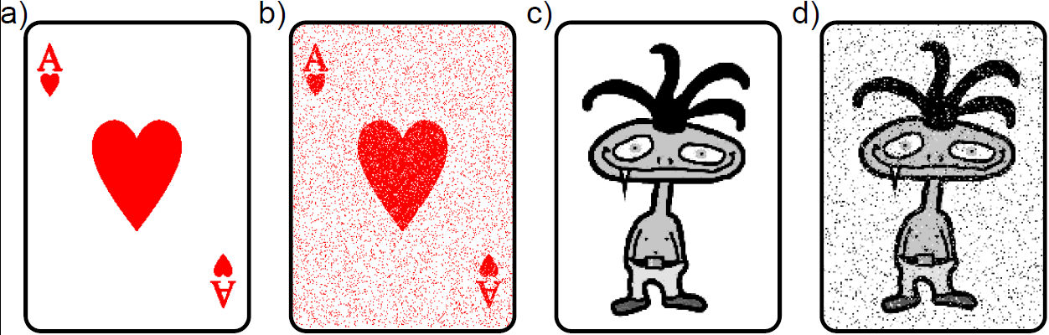
Binary Denoising
Before
After
Image represented as binary discrete variables. Some proportion of pixels randomly changed polarity.

Slide 4
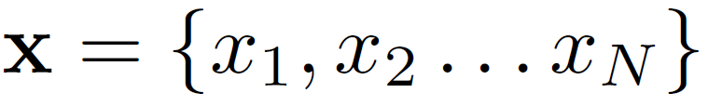
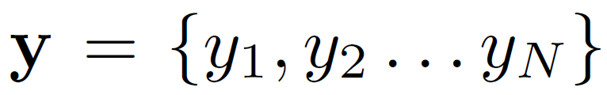
Denoising Task
Observed Data
Uncorrupted Image

Slide 5
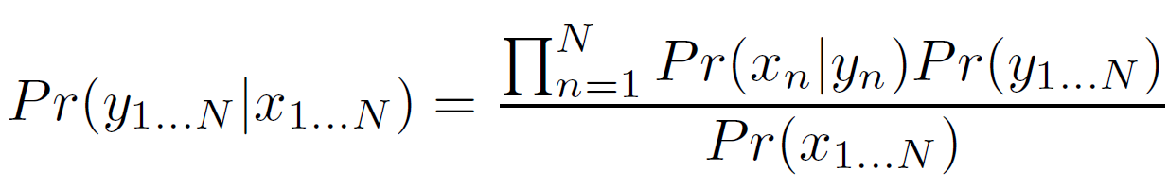
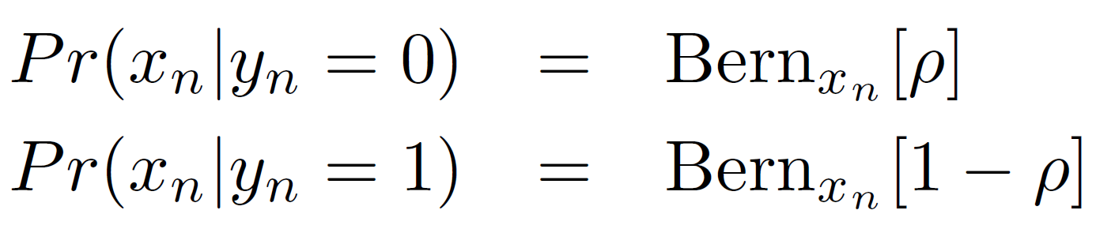
Denoising
Bayes’ rule:
Likelihoods:
Prior: Markov random field (smoothness)
MAP Inference: Graph cuts
Many other vision tasks have this structure (stereo, segmentation etc.)

Slide 6
Plan of Talk
Denoising problem
Markov random fields (MRFs)
Max-flow / min-cut
Binary MRFs –submodular (exact solution)

Slide 7

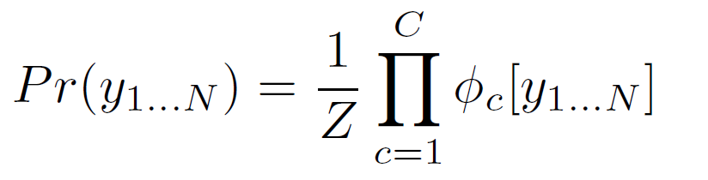
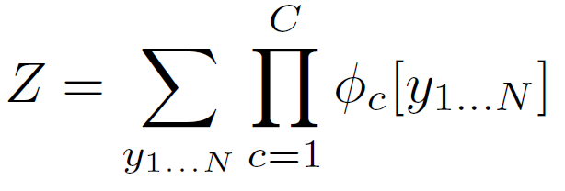
Undirected Models
MRF is an example of an undirected model
Product of positive potential functions
Z is a normalizing constant
Z referred to as “partition function”

Slide 8

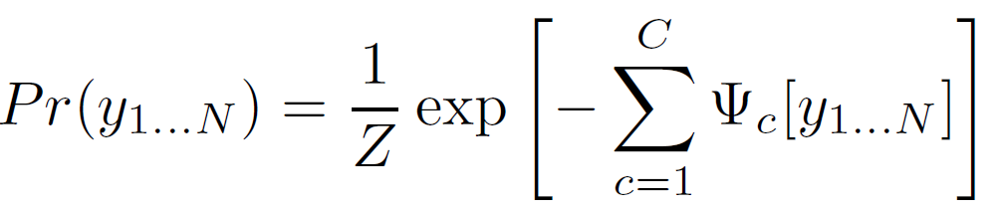

Alternate Formulation
Product of positive potential functions
or product of exponential costs
where

Slide 9
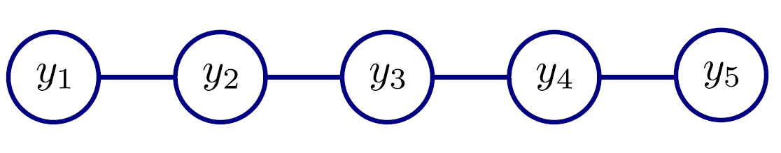
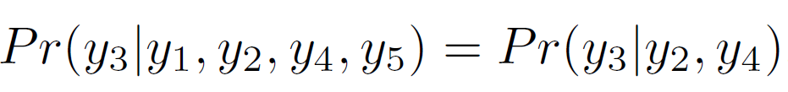
MRF Example
Consider a product of functions over neighbours
In this model a variable is conditionally independent of all the others given its neighbours
For example
So connections in graphical model (top) tell us about independence relations

Slide 10
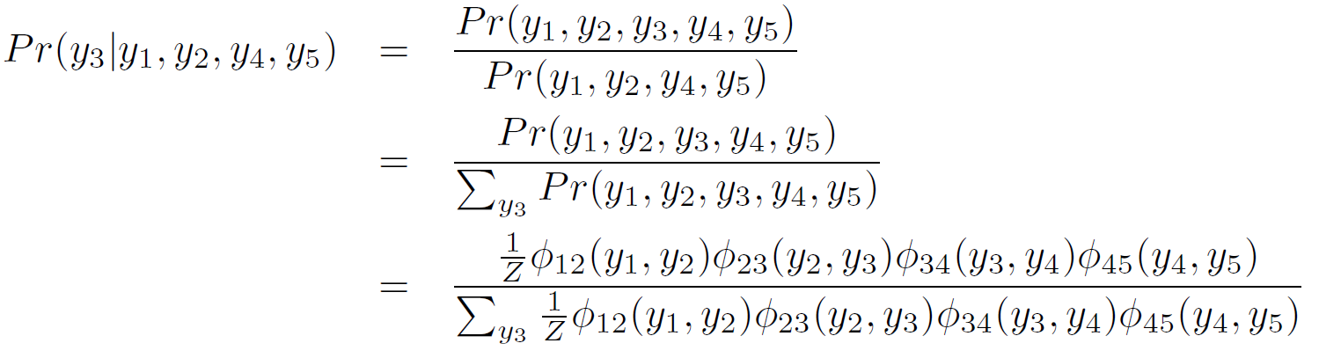
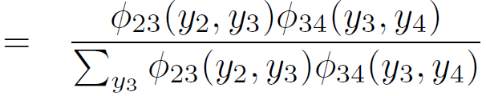
Proof of Markov Property
Using conditional probability relation
(only depends on neighbours)

Slide 11
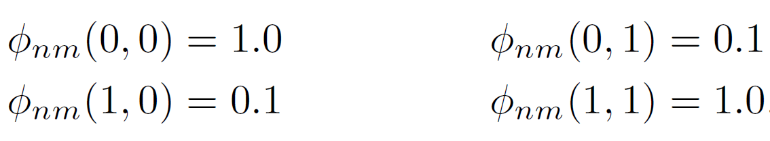
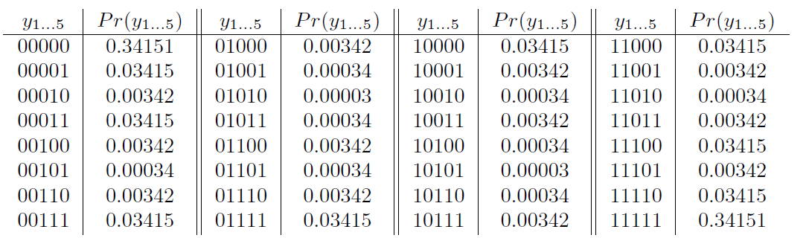
MRF Example
Consider the case where variables are binary, so functions return 4 different values depending on the combination of neighbours. Let’s choose

Slide 12
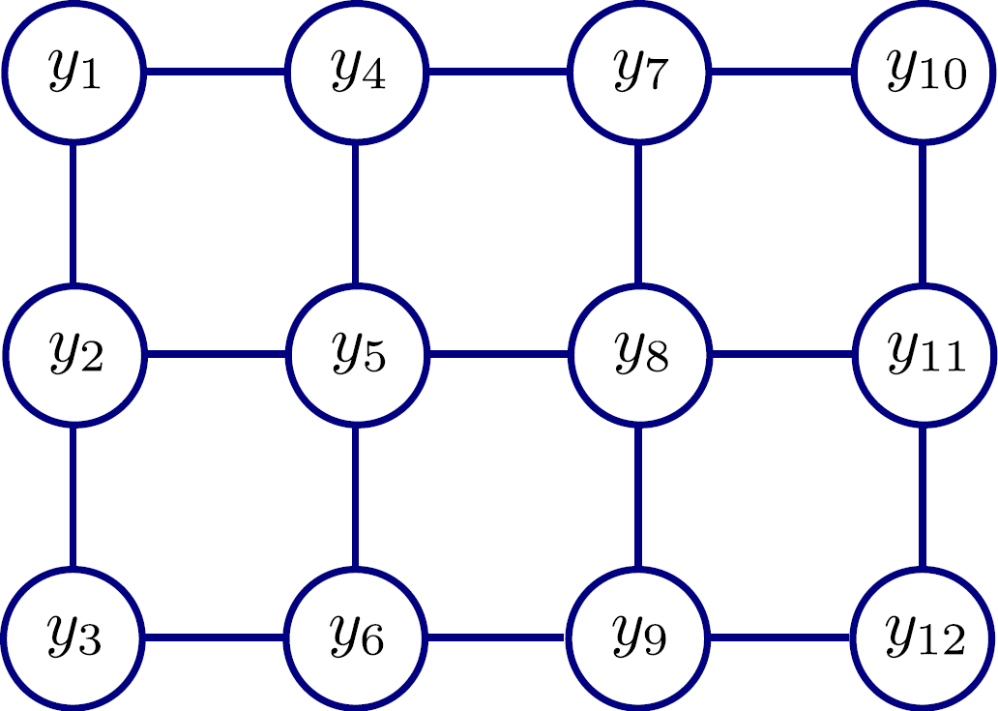
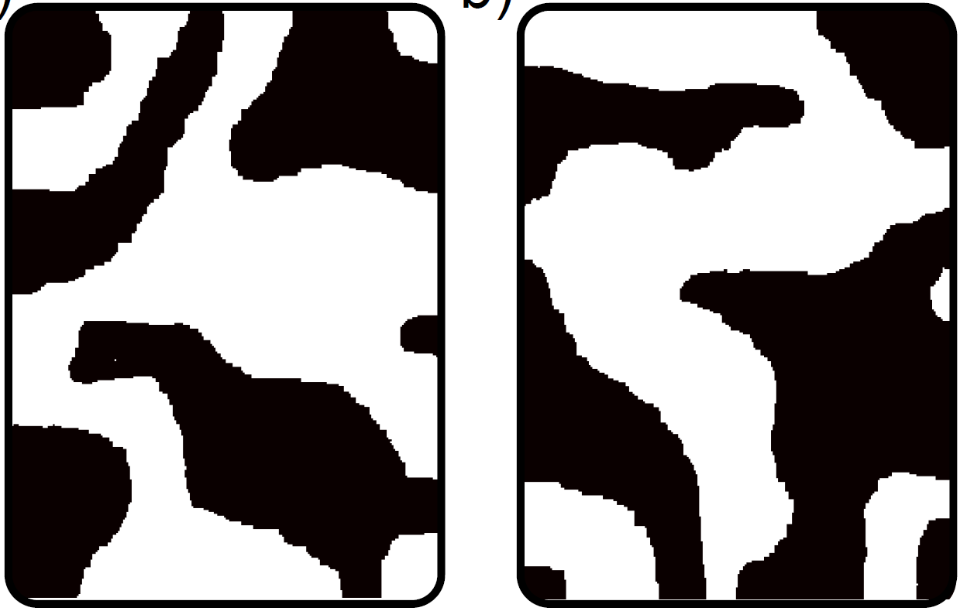
2D MRF Example
Product of pairwise functions between neighbouring variables.
Lower probability if don’t take the same value.
Samples from this distribution look like mostly smooth images

Slide 13
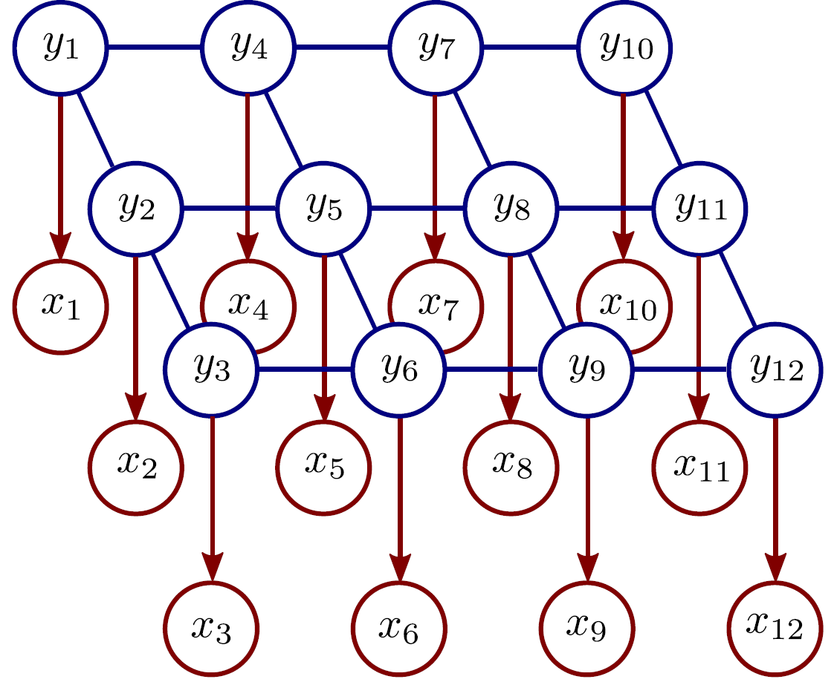
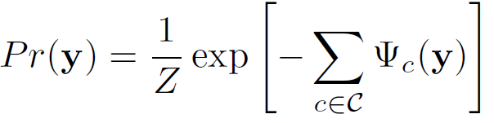
Denoising with MRFs
MRF Prior (pairwise cliques)
Original image, y
Likelihoods
Observed image, x
Inference via Bayes’ rule:

Slide 14
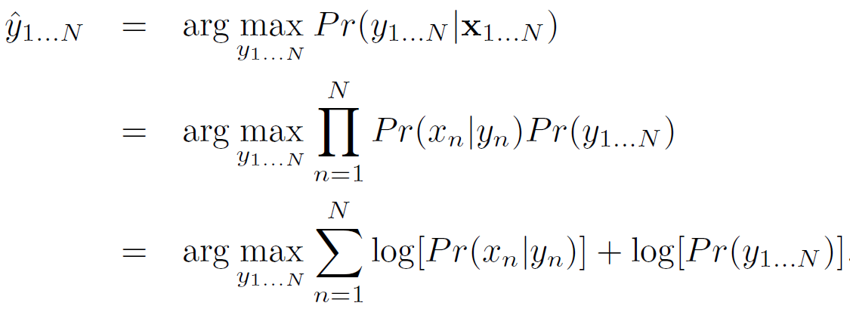
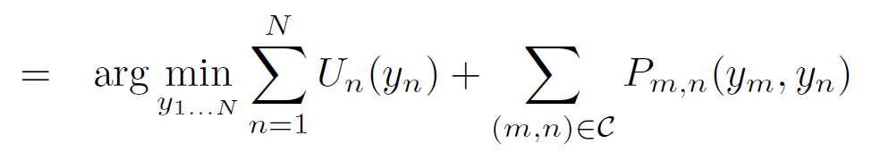
MAP Inference
Unary terms
(compatability of data with label y)
Pairwise terms
(compatability of neighboring labels)

Slide 15
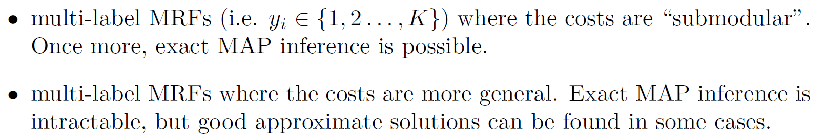
Graph Cuts Overview
Graph cuts used to optimise this cost function:
Unary terms
(compatability of data with label y)
Pairwise terms
(compatability of neighboring labels)
Three main cases:

Slide 16
Graph Cuts Overview
Graph cuts used to optimise this cost function:
Unary terms
(compatability of data with label y)
Pairwise terms
(compatability of neighboring labels)
Approach:
Convert minimization into the form of a standard CS problem,
MAXIMUM FLOW or MINIMUM CUT ON A GRAPH
Low order polynomial methods for solving this problem are known

Slide 17
Plan of Talk
Denoising problem
Markov random fields (MRFs)
Max-flow / min-cut
Binary MRFs - submodular (exact solution)

Slide 18
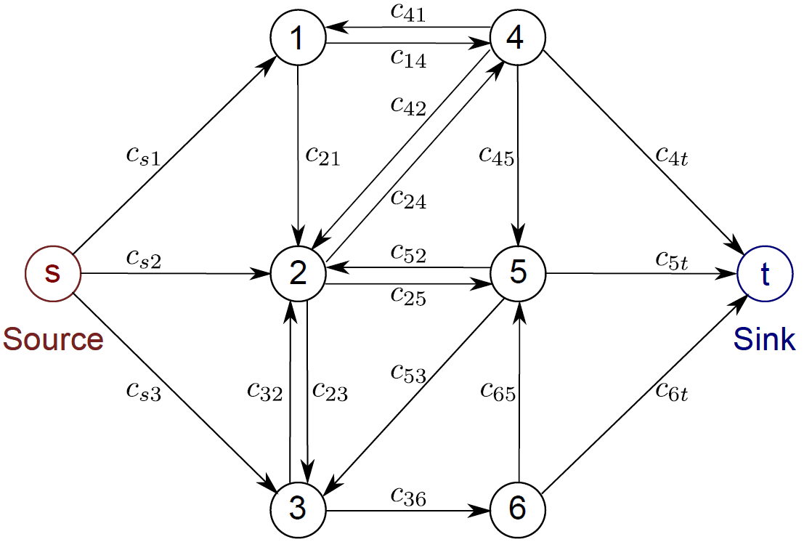
Max-Flow Problem
Goal:
To push as much ‘flow’ as possible through the directed graph from the source to the sink.
Cannot exceed the (non-negative) capacities c_{ij} associated with each edge.

Slide 19
Saturated Edges
When we are pushing the maximum amount of flow:
There must be at least one saturated edge on any path from source to sink
(otherwise we could push more flow)
The set of saturated edges hence separate the source and sink

Slide 20
Min Cut
Define a cut on the graph as a set of edges that separate the source and sink.
Cost of cut = total capacity of these edges
Edges that saturate in the maximum flow solution form the minimum cost cut
Can talk interchangeably about max-flow or min-cut

Slide 21
Plan of Talk
Denoising problem
Markov random fields (MRFs)
Max-flow / min-cut
Binary MRFs – submodular (exact solution)

Slide 22
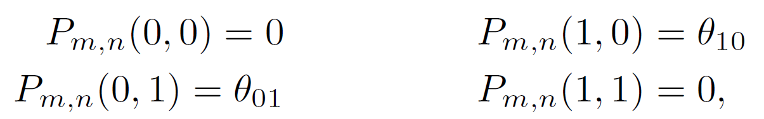
Graph Cuts: Binary MRF
Graph cuts used to optimise this cost function:
Unary terms
(compatability of data with label y)
Pairwise terms
(compatability of neighboring labels)
First work with binary case (i.e. True label y is 0 or 1)
Constrain pairwise costs so that they are “zero-diagonal”

Slide 23
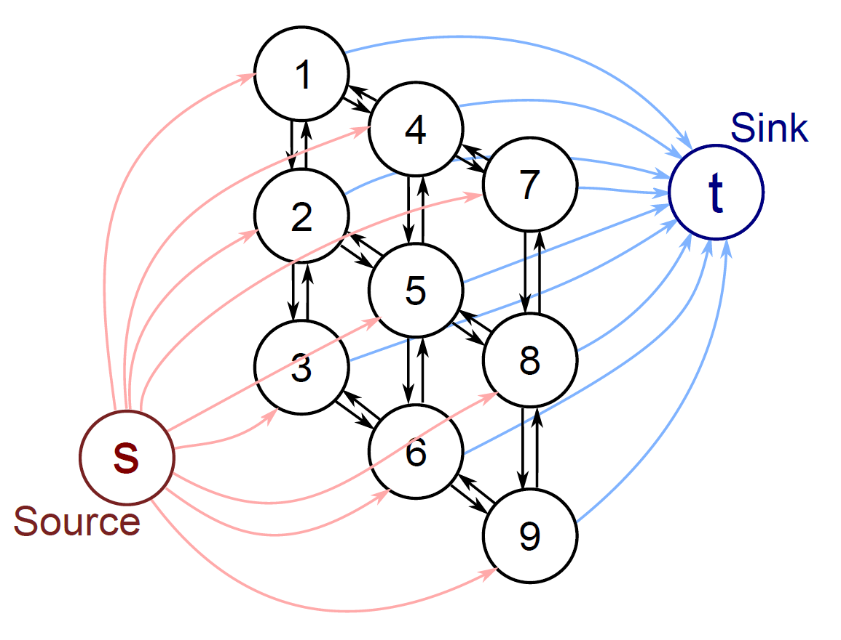
Graph Construction
One node per pixel (here a 3x3 image)
Edge from source to every pixel node
Edge from every pixel node to sink
Reciprocal edges between neighbours
Note that in the minimum cut EITHER the edge connecting to the source will be cut, OR the edge connecting to the sink, but NOT BOTH (unnecessary).
Which determines whether we give that pixel label 1 or label 0.
Now a 1 to 1 mapping between possible labelling and possible minimum cuts

Slide 24
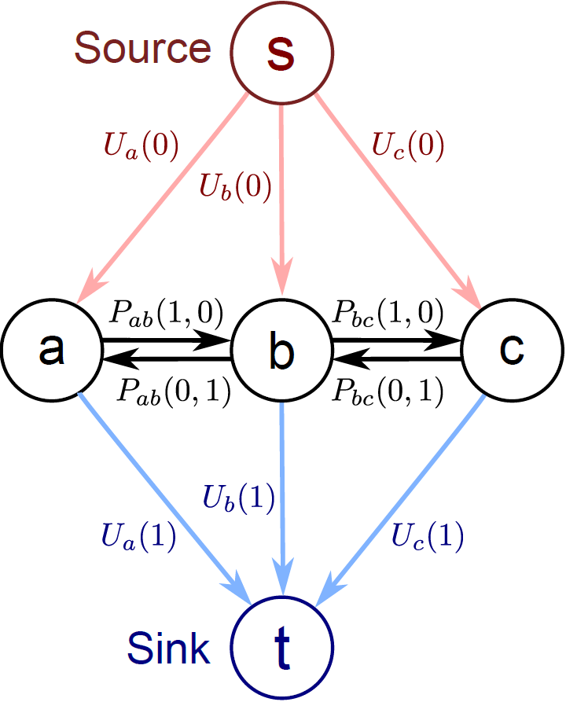
Graph Construction
Now add capacities so that minimum cut, minimizes our cost function
Unary costs U(0), U(1) attached to links to source and sink.
Either one or the other is paid.
Pairwise costs between pixel nodes as shown.
Why? Easiest to understand with some worked examples.

Slide 25
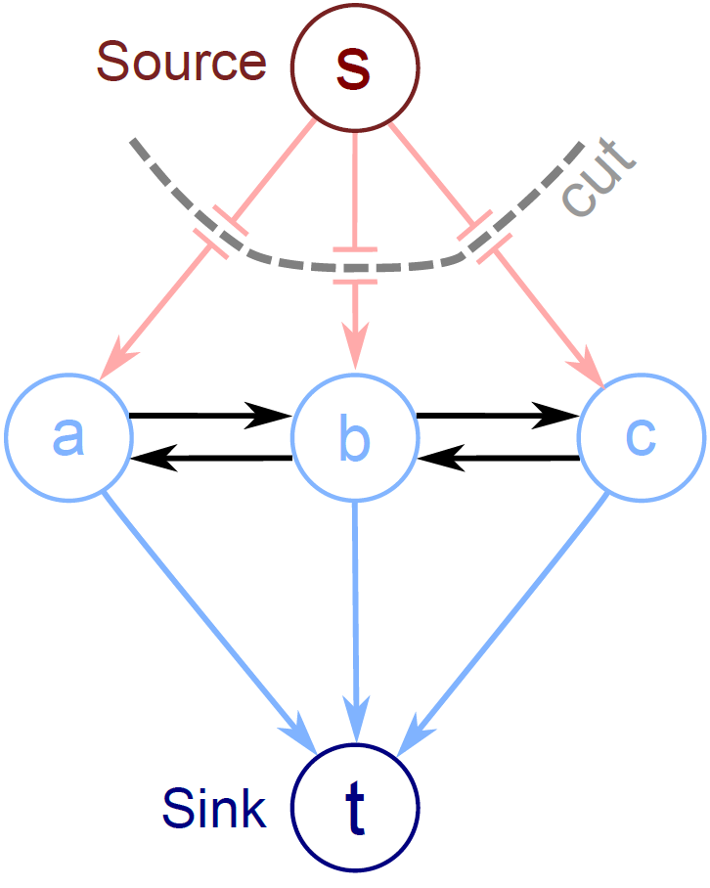
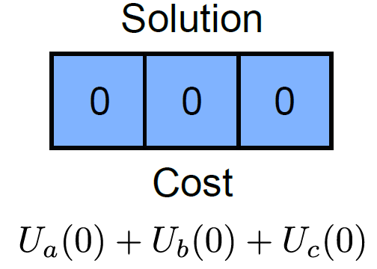
Example 1

Slide 26
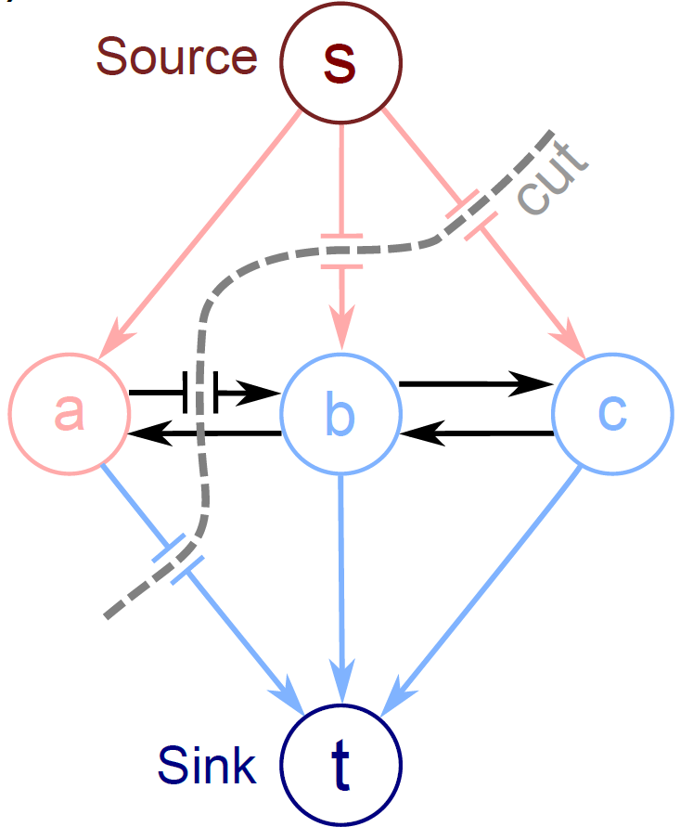
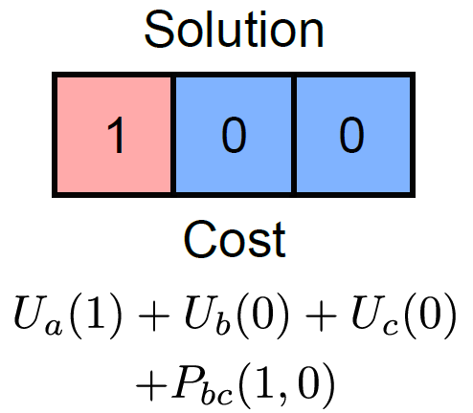
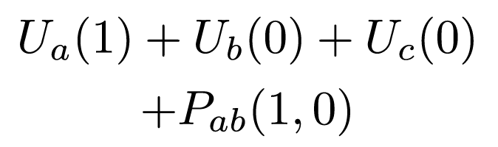
Example 2

Slide 27
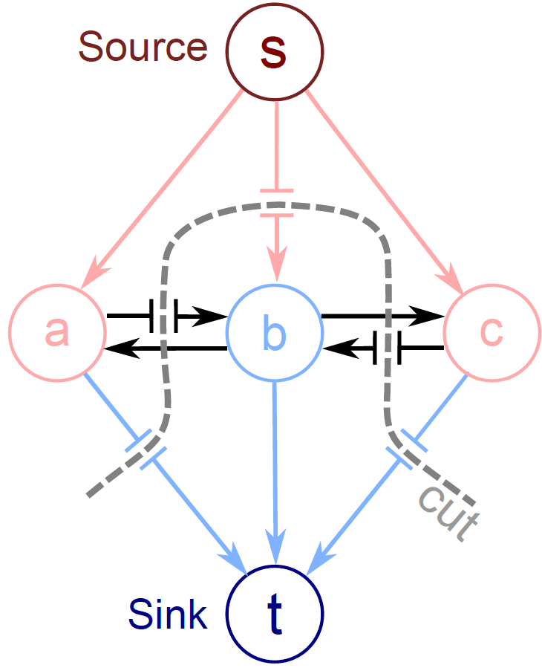
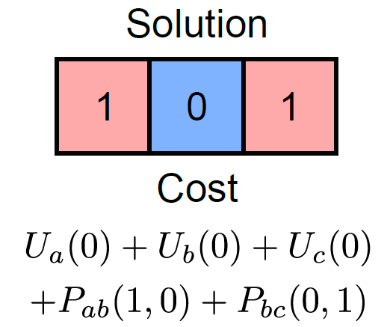
Example 3

Slide 28
Graph Cuts: Binary MRF
Graph cuts used to optimise this cost function:
Unary terms
(compatability of data with label y)
Pairwise terms
(compatability of neighboring labels)
Summary of approach
Associate each possible solution with a minimum cut on a graph
Set capacities on graph, so cost of cut matches the cost function
Use augmenting paths to find minimum cut
This minimizes the cost function and finds the MAP solution

Slide 29
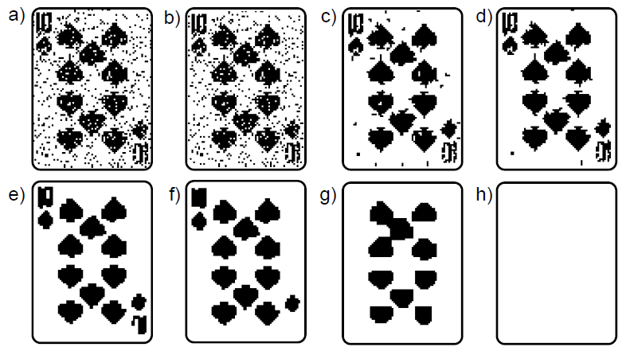
Denoising Results
Original
Pairwise costs increasing
Pairwise costs increasing

Slide 30
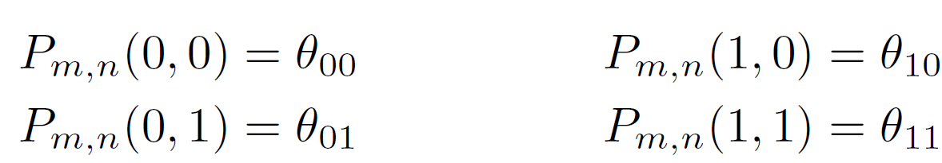
Things I haven’t told you!
How to solve the max flow problem
How to use more general costs (not always possible)
How to generalize to more labels.
sometimes possible exactly (Schlesinger & Flach)
sometimes approximately (alpha expansion)
sometimes NP hard

Slide 31
The End
Contact me if you want slides or notes s.prince@cs.ucl.ac.uk

